Slide 1
Ai powered energy management system for industrial facilities
To Optimise energy consumption
Team : STELLAR
Lead : J Indra Karan Rao
Team Member : Shubhankar

Slide 2
Problem Description
The lack of visibility and control over energy usage makes it difficult for businesses to manage their energy costs and reduce their carbon footprint
often require manual intervention to operate Energy management system effectively.
To address these challenges, an Al-powered energy management system can be developed that uses machine learning algorithms and data analytics to optimize energy consumption in industrial and commercial facilities.

Slide 3
Approaches
A user friendly Website is developed to industry persons to monitor their Equipment and process Energy Consumption Analysis as per the Energy Management Guidelines provided by the BEE India to manage their energy costs and reduce their carbon footprint
Identifying Optimal Load Scheduling approaches and integrating with the PLC automate things in Industry Level
An Al-powered energy management system is developed that uses Random Forest Regressor, NLP module predictions, Recommendations and data analytics to identify Anomalies and reduce the excess consumption of Energy by the equipment's

Slide 4
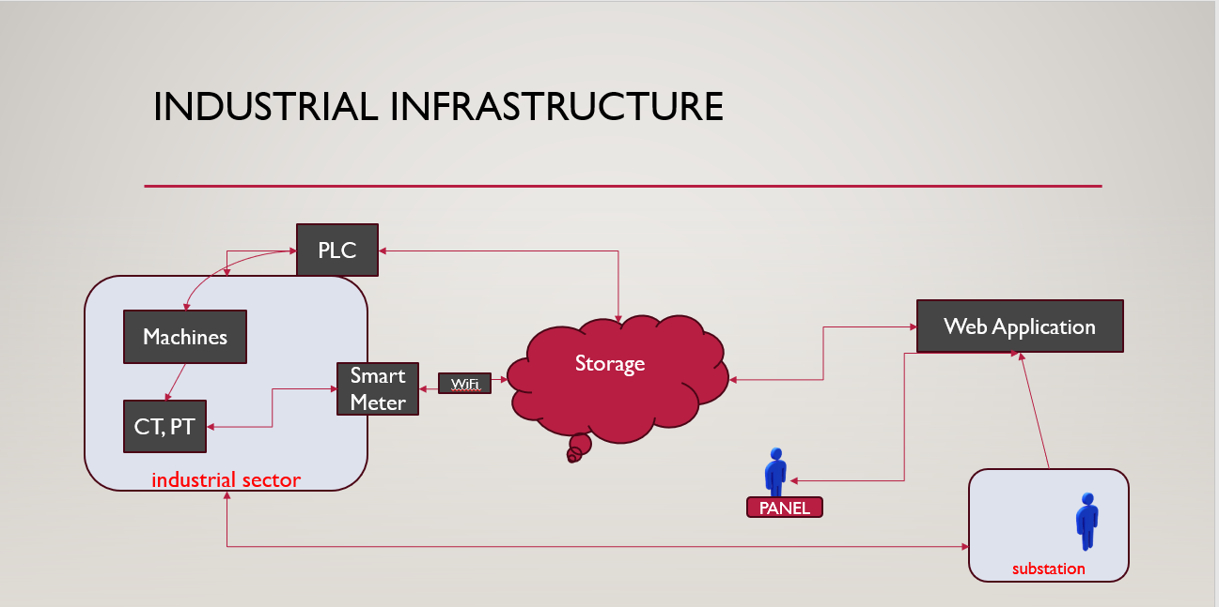
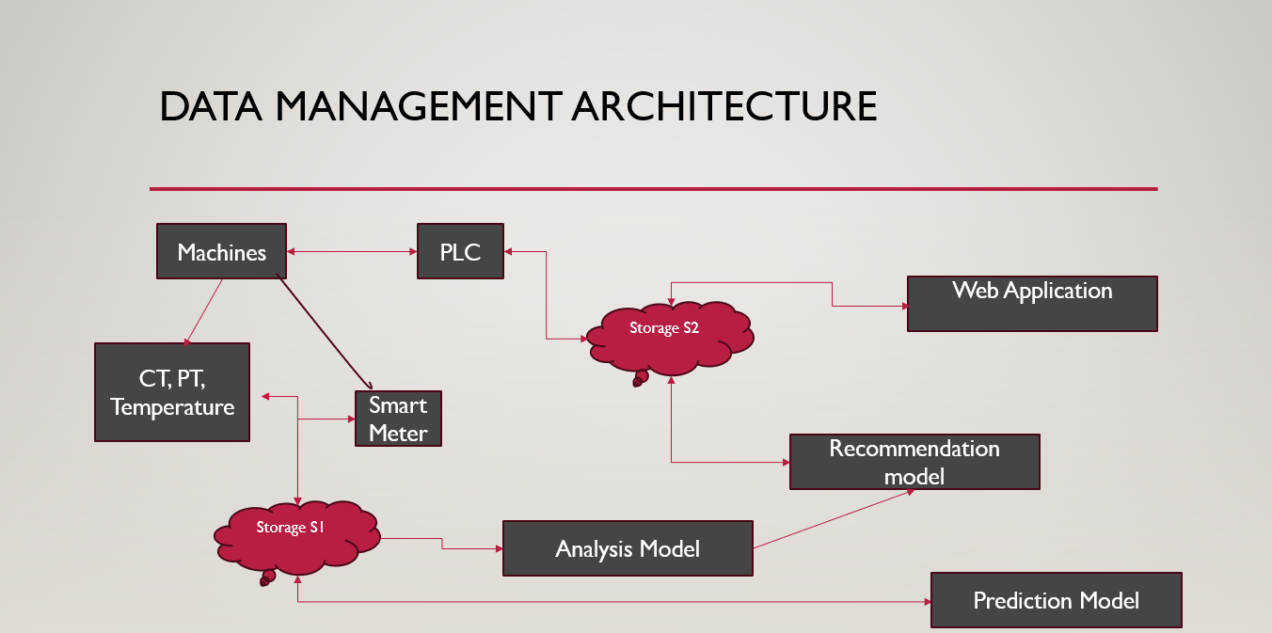
Architectures

Slide 5
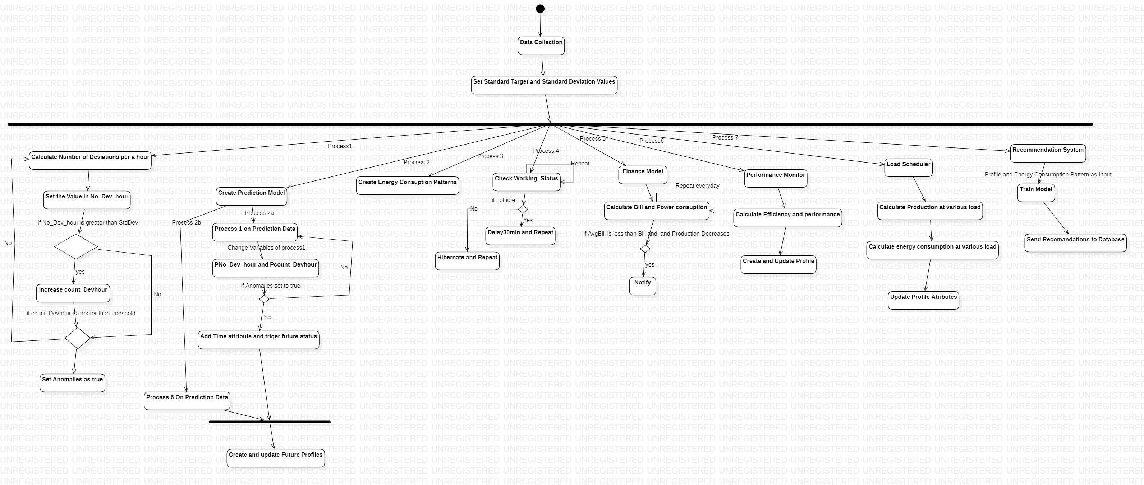
Overflow

Slide 6
Load scheduling and management approach
Identify the optimal substation for Production to meet demand
Create profiles to individual machines and categorise them basing parameters : Production/hour, power factor, temperature, efficient Time Period
Build Recommendation Engine by performing all the approach's of load scheduling by clustering the machines based on above parameters virtually and identifying the optimal approach for production
Extract the data : { Efficient Timeperiod , Fault probability } by predating the probability of machine condition from the Power factor and temperature data using Predictive analysis.

Slide 7
Tech Stack:
IOT : Thing Speak to collect data from CT,PT, Temperature sensor and smart meter ( PZEM004T , ESP8266 )
Web Application : Firebase – React – TypeScript
Predictive Analysis : Random Forest Regressor
Recommendation : NLP
Analysis : Custom Approach based on BEE ministry of power

Slide 8
conclusion
1. Cost savings: By optimizing energy consumption, the system will help businesses reduce their energy bills and save money. The Al-powered system will continuously analyze energy usage patterns and provide recommendations for energy-efficient practices that can help reduce energy waste and costs.
2. improved energy efficiency: The system will enable businesses to monitor and control their energy consumption in real-time, allowing them to identify areas of inefficiency and implement solutions to improve energy efficiency.
3.Reduced carbon footprint: By reducing energy waste, the system will help businesses reduce their carbon footprint and contribute to a more sustainable future
4. Scalability: The Al-powered energy management system will be designed to be scalable and adaptable to different types of industrial and commercial facilities.
5. User-friendliness: The system will be designed with a user-friendly interface, making it easy for facility managers and building owners to monitor and control energy usage.

